Slide 1
"Building a Loosely Coupled Architecture with Amazon SQS
Samaresh Kumar Pradhan | SimpliLearn

Slide 2
Project Description
The project aims to manage a tightly coupled architecture using Amazon SQS.
In a traditional tightly coupled architecture, applications communicate with each other directly, leading to potential issues if one of the applications is down.
Amazon SQS provides a way to make applications highly available by facilitating communication through an SQS queue.
The project involves building a customer web application that interacts with backend applications via an SQS queue, allowing the web application to continue working with buffered messages in case the backend applications are down.
Once the backend application is up, it can start polling messages from the SQS queue to update the database, making the applications loosely coupled and not dependent on the status of each other.
The project requires the use of various AWS services, including SQS, EC2, IAM, and RDS.
A successful project will result in a loosely coupled architecture that is more resilient and highly available.

Slide 3
Project Scope
The project aims to demonstrate the use of Amazon SQS and Spring Boot to manage a tightly coupled architecture and improve the resiliency of the system.
The project will involve building a customer producer and consumer application using Spring Boot those are publishing & interacts with backend applications via an SQS queue.
The backend applications will be built using Spring Boot and will be hosted on Amazon EC2 instances, using an RDS MySQL database to store data.
IAM will be used to manage user permissions and access to resources.
The project will focus on ensuring that the communication between the applications is reliable and the system is highly available, even if one or more of the backend applications are down.
This involves designing the architecture & implementing the system using Spring Boot, & AWS best practices
The project will not involve building a production-ready system, but rather a proof of concept that demonstrates the benefits of using Amazon SQS and Spring Boot to manage a tightly coupled architecture.
Notes:
May require more than one slide

Slide 4
Objectives
Identify overall project objectives:
Demonstrate the benefits of using Amazon SQS and Spring Boot to manage a tightly coupled architecture and improve the resiliency of the system.
Build a customer application that interacts with backend applications via an SQS queue, allowing the application to continue working with buffered messages in case the backend applications are down.
Use AWS services, including Amazon SQS, EC2, IAM, and RDS, to build a scalable and highly available system.
Use Spring Boot to build the backend applications, leveraging its features to improve the performance, reliability, and maintainability of the system.
Design and implement a loosely coupled architecture that is more resilient and fault-tolerant, reducing the impact of downtime on the system and the users.
Develop skills and knowledge in building cloud-native applications and using AWS services and Spring Boot to build scalable and robust systems.
Document the design, implementation, and results of the project in a report or presentation, showcasing the benefits of using Amazon SQS and Spring Boot to manage a tightly coupled architecture.
Non-goals
Building a production-ready system that is fully optimized for performance, security, and cost efficiency. The project is a proof of concept and will not be optimized for all production-level concerns.
Integrating with other third-party services or applications that are not directly related to the project objectives.

Slide 5
Deliverables
A report or presentation that describes the design and implementation of the system, the technologies used, and the benefits of using Amazon SQS and Spring Boot to manage a tightly coupled architecture.
A code repository that contains the source code of the customer web application, backend applications, and any scripts or configurations required to deploy the system.
A deployment guide that describes the steps required to deploy the system to an AWS account, including how to set up the required AWS resources, deploy the application code, and configure the system.
A test plan that describes how the system will be tested to ensure that it meets the project objectives and performs as expected.
A user manual that describes how to use the system and its features, including how to interact with the customer application and backend applications, and how to monitor the system using AWS tools and services.

Slide 6
Success Factors
Demonstrating the benefits of using Amazon SQS and Spring Boot to manage a tightly coupled architecture, such as improving the resiliency, fault tolerance, and scalability of the system.
Building a customer web application and backend applications that interact with each other through an SQS queue, showing that the system can continue working even if one or more components are down/unavailable.
Implementing a loosely coupled architecture that separates the concerns of each component, reducing the impact of downtime and making the system more resilient and fault-tolerant.
Using AWS services such as SQS, EC2, IAM, and RDS to build a scalable and highly available system that can handle varying levels of traffic and data load.
Using Spring Boot to build the backend applications, leveraging its features to improve the performance, reliability, and maintainability of the system.
Creating clear and concise documentation for the system, including a report or presentation, a code repository, a deployment guide, a test plan, test cases and scripts.
Completing the project within the allocated timeline and delivering a system that meets or exceeds the project objectives and requirements.

Slide 7
Project Team Roles and Responsibilities
Ritesh Behal
Trainer
SimpliLearn Success Manager
Administrative Assistant
Samaresh Kumar Pradhan
Trainee

Slide 8
Implementation
TASK / Activities
Gathered requirements & developed the system architecture and database schema
Implement the backend logic using Java and Spring Boot
Test the system for functionality, performance, and security
Deploy the system to Amazon Web Service AWS
Procedures:
Agile software development methodology is used while developing this project
Tools/Technology:
Java, Maven, Spring Boot for backend development, MySQL on RDS for the database, AWS for cloud hosting & Github for version control
Project Change Control Process:
Any proposed changes to the project must be documented and submitted for review by the project manager and/or the project stakeholders
Notes:
May require more than one slide

Slide 9
Resources
People
Samaresh Kumar Pradhan
Equipment
Windows 10 64 bit laptop
AWS cloud
Java
Notes
Locations
AWS
Outside Services
Notes
Java, MySQL Workbench installation
Notes
Manufacturing
SimpliLearn, AWS
Notes
Ritesh Behal
SimpleLearn Success Manager
Notes

Slide 10
Project Schedule and Milestones
Course Started
Course Completed
Project Started
Project Submitted
14-01-2023
05-02-2023
06-02-2023
17-02-2023

Slide 11
Quality Management and Performance Measures
Committed to provide the best solution for the project
Tried to deliver all project deliverables on time and within budget
Ensured that all deliverables meet or exceed the required quality standards
Minimized defects, rework, and waste by using established processes and best practices
Continuously improved processes and practices to enhance quality and efficiency
Ensured that all team members understand and follow the quality plan and standards
Verified that all project requirements are met & Conducting tests and inspections of project deliverables
Verified that all defects are corrected and retested
Followed industry-standard software development practices and methodologies
Notes:
May require more than one slide

Slide 12
Steps In Detail
Created an account in AWS
Created IAM role by granting S3 and SQS Full Access
Lunched EC2 instance, installed Jdk 19 on top of this and attached the IAM role as well
Created a SQS queue and S3 Bucket
Created 2 Java spring boot application i.e. one for Producer and one for Consumer
Uploaded the above 2 jars to s3 bucket
Connected with EC2 with the previously downloaded key pair
Created 2 folder i.e. producer and consumer to store the 2 executable jar file
Used aws s3 command to bring both the jars to their respective folder
Finally invoked “java –jar with –Dserver.port” to run both the jars

Slide 13
Steps to install JDK 19 on EC2
java –version (We will get command not found exception )
wget https://download.oracle.com/java/19/latest/jdk-19_linux-x64_bin.tar.gz
tar zxvf jdk-19_linux-x64_bin.tar.gz
sudo mv jdk-19.0.2 /usr/share/
sudo vim /etc/profile
#add
export JAVA_HOME=/usr/share/jdk-19.0.2
export PATH=$JAVA_HOME/bin:$PATH
export CLASSPATH=.:$JAVA_HOME/lib/dt.jar:$JAVA_HOME/lib/tools.jar
javac -version
java -version

Slide 14
Steps to Create MySql DB on RDS
Log in to the AWS Management Console and navigate to the RDS dashboard.
Click the "Create database" button.
Select the "MySQL" engine type.
Choose the version of MySQL you want to use.
Choose a database instance class based on your needs.
Set up the networking and security options, such as the VPC, subnets, security group, and availability zone.
Set up the database options, such as the database name, username, password, and storage settings.
Review the configuration and click "Create database" to create the MySQL database instance.

Slide 15
Important Spring boot-AWS-JPA application configuration
Here we provide a configuration for the data source & entity manager for the message consumer application.
The configuration sets the data source properties, entity manager factory properties, transaction manager properties, and JPA vendor adapter
The code provides additional configuration for AWS credentials provider & entity manager factory builder.
DataSource Configuration
The dataSource() method configures the data source for the application using the DriverManagerDataSource class.
The method sets the properties for the data source including the driver class, URL, username, and password using dataSourceProperties object
EntityManager Configuration
The entityManagerFactory() method configures the entity manager factory using the LocalContainerEntityManagerFactoryBean class.
The method sets the data source for the entity manager using dataSource object.
The method specifies the package name where the entities are located and defines the persistence unit name as "messages".
The method also sets the properties for Hibernate using getHibernateProperties() method
Transaction Manager Configuration
The awsCredentialsProvider() method configures the AWS credentials provider using the InstanceProfileCredentialsProvider class.
The entityManagerFactoryBuilder() method builds the entity manager factory using the EntityManagerFactoryBuilder class.
JPA Vendor Adapter Configuration
The jpaVendorAdapter() method configures the JPA vendor adapter using the HibernateJpaVendorAdapter class.
The method sets the database type as MySQL, generates DDL statements, and enables SQL logging.
Additional Configuration
The awsCredentialsProvider() method configures the AWS credentials provider using the InstanceProfileCredentialsProvider class.
The entityManagerFactoryBuilder() method builds the entity manager factory using the EntityManagerFactoryBuilder class.

Slide 16
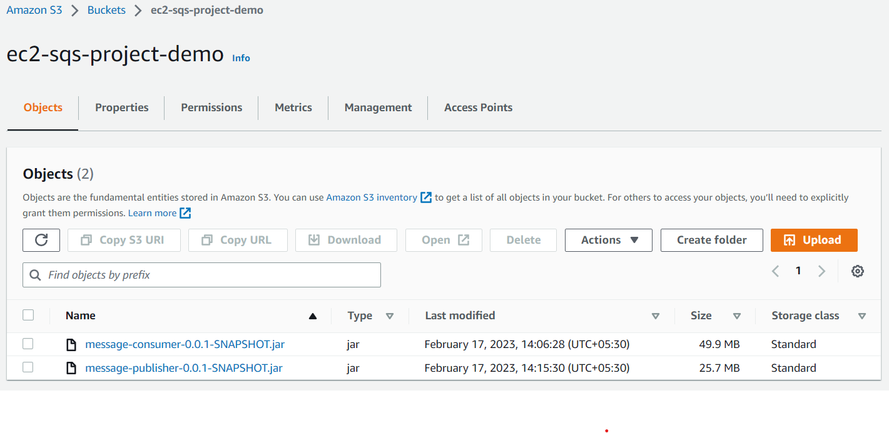
Live Screen Shots Of S3 Bucket

Slide 17
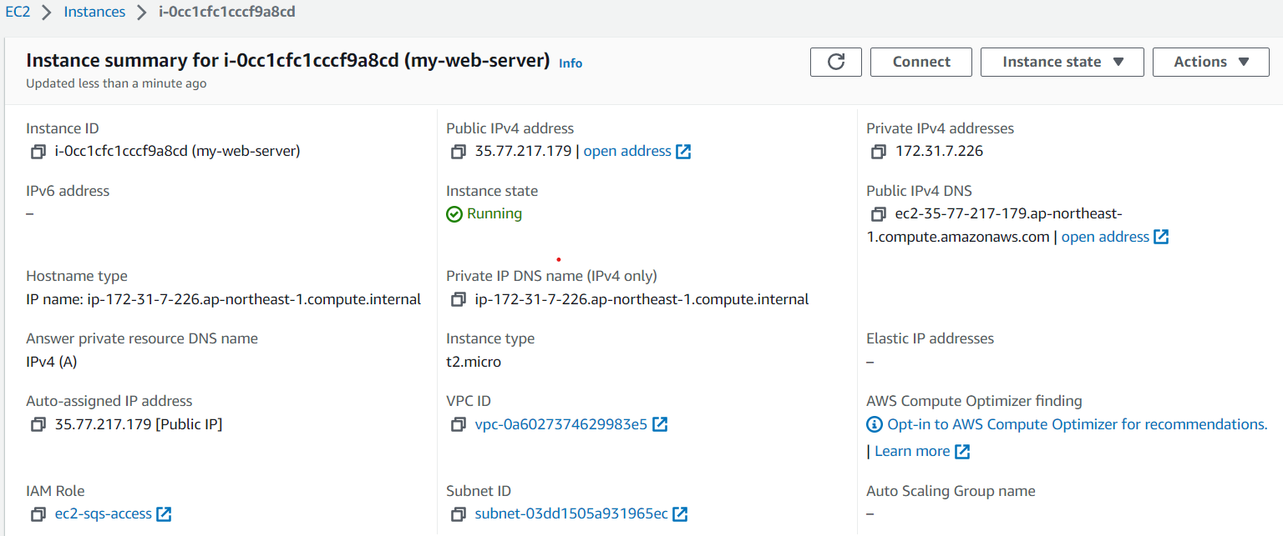
Live Screen Shot of EC2 instance

Slide 18
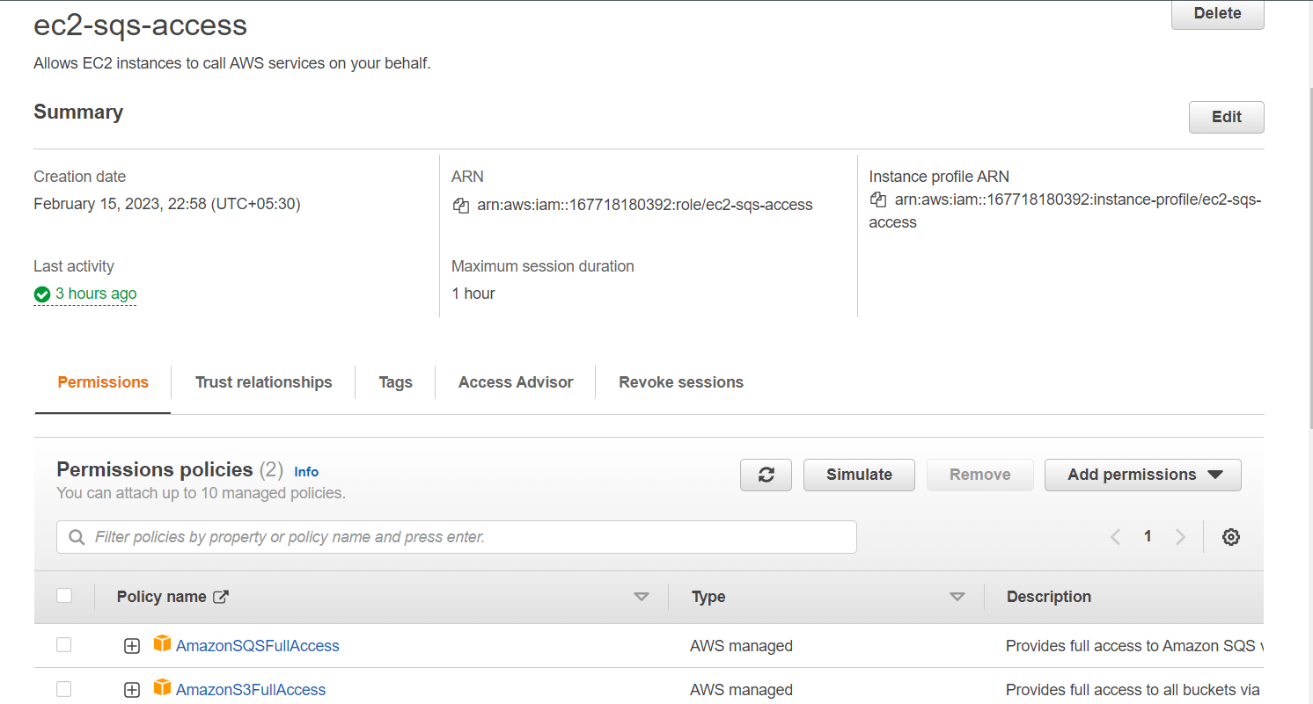
Live Screen Shot of IAM Roles

Slide 19
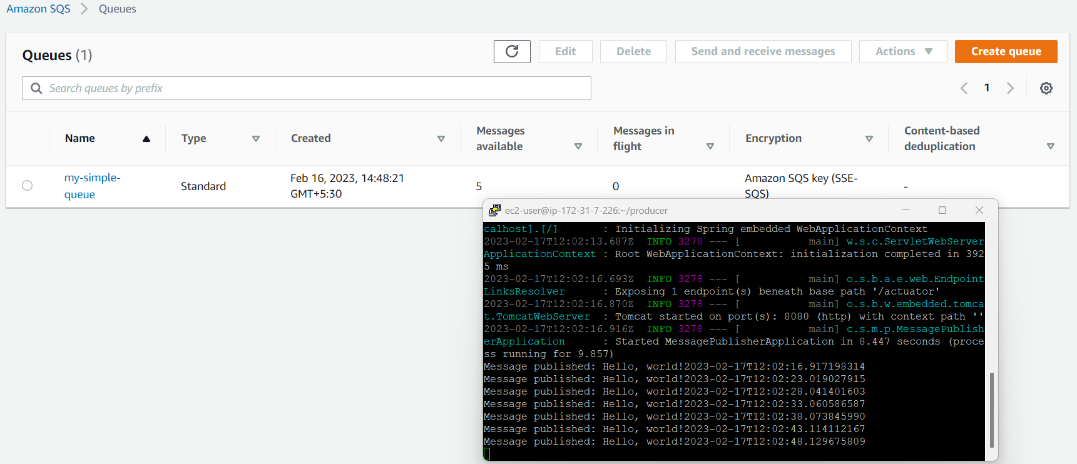
Live Screen Shot Of SQS

Slide 20
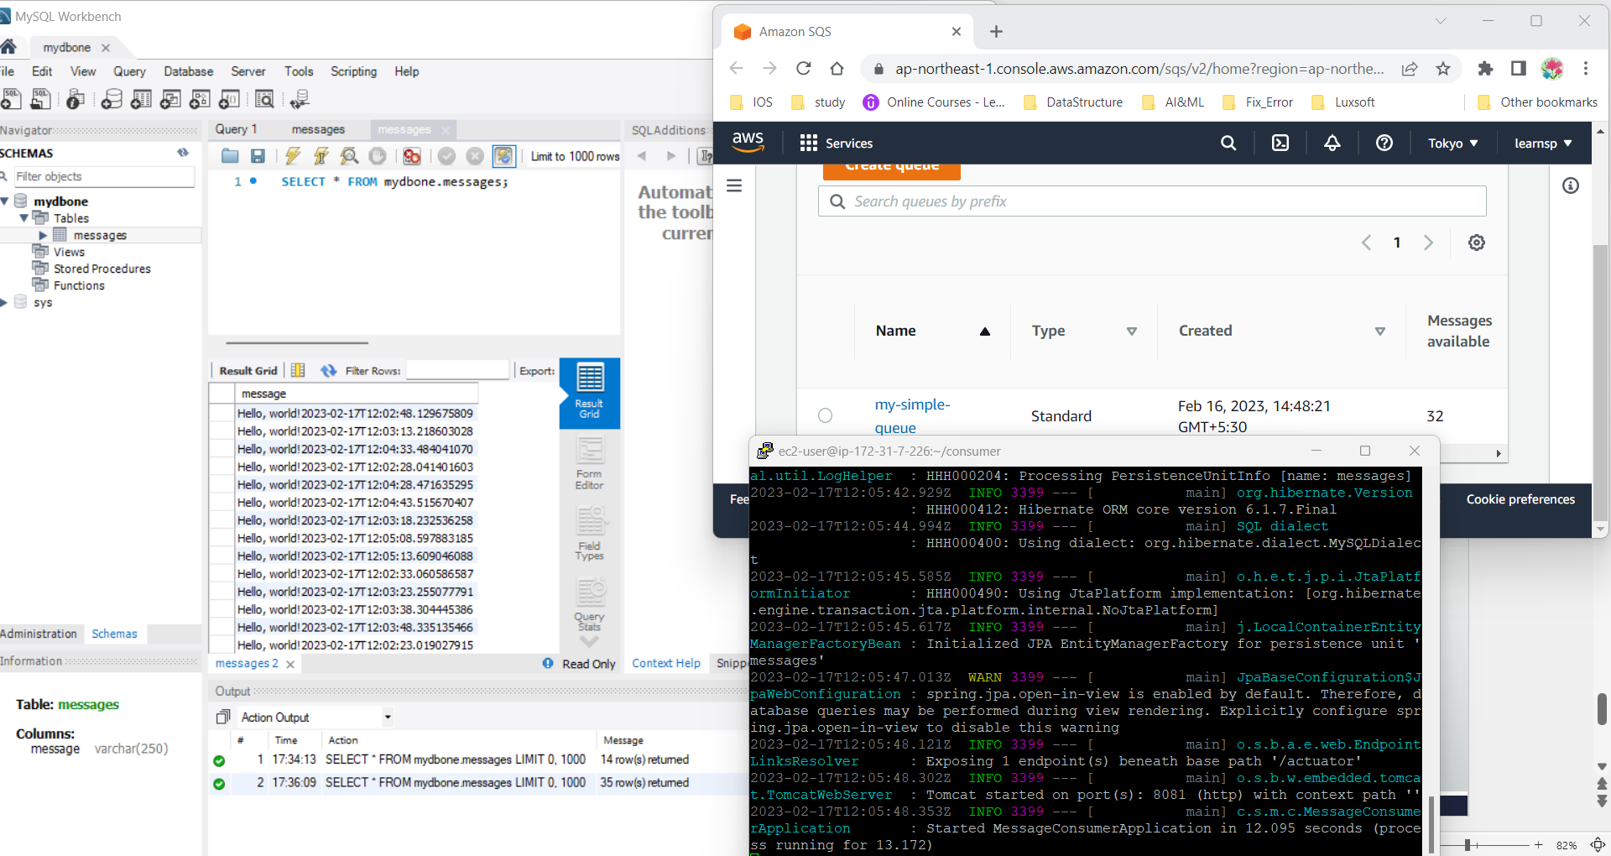
Live Screen Shot of Consumer Application

Slide 21
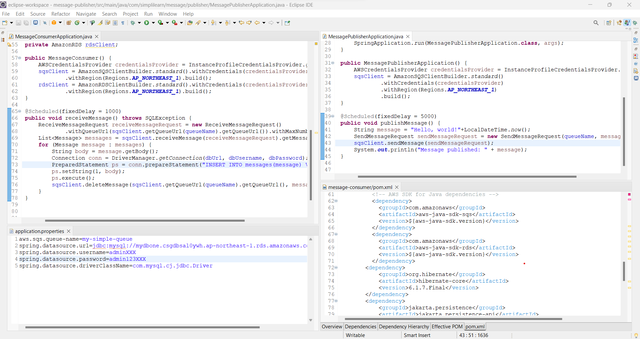
Live Screen Shot Of Spring-Boot application

Slide 22
Appendix
Github Repo : https://github.com/skpradhan-repo/SimpleLearnTraining

